Slide 1
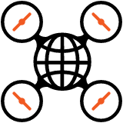
Aerial Images to Maps
Technological Advancements with OpenDroneMap

Slide 2
What is OpenDroneMap?

Slide 3
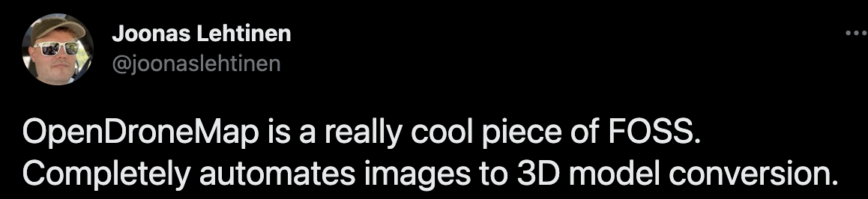
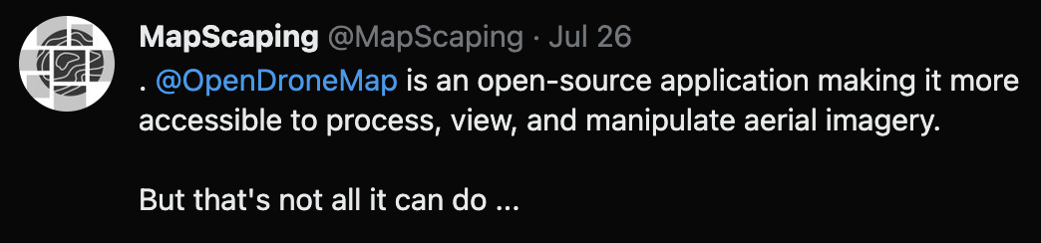
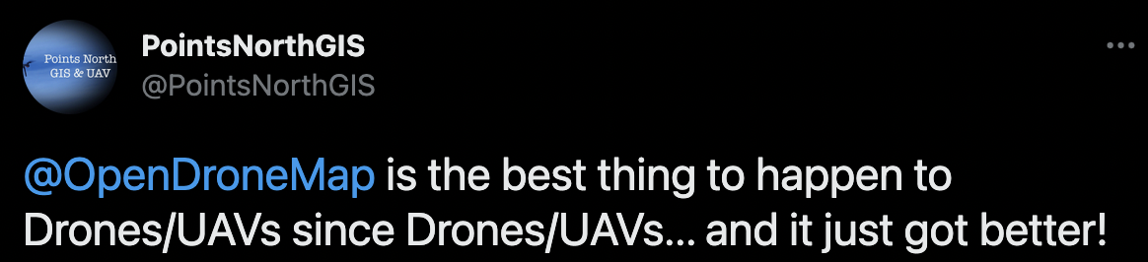
What is OpenDroneMap?

Slide 4
What is OpenDroneMap?
An ecosystem of tools
FOSS
Actively developed
Well supported
Well documented
Comparable or better than proprietary alternatives
A friendly community
Available on opendronemap.org

Slide 5
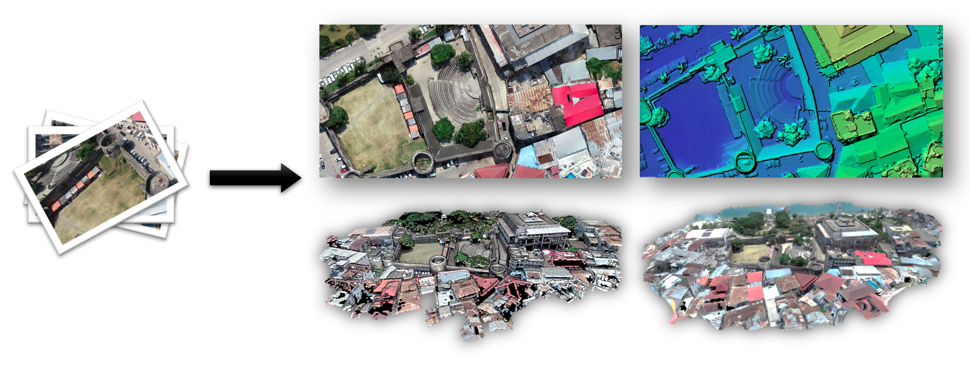
What is OpenDroneMap?
Mji Mkongwe, Stone Town, Zanzibar, Tanzania. Federico Debetto, KMedia SAS

Slide 6
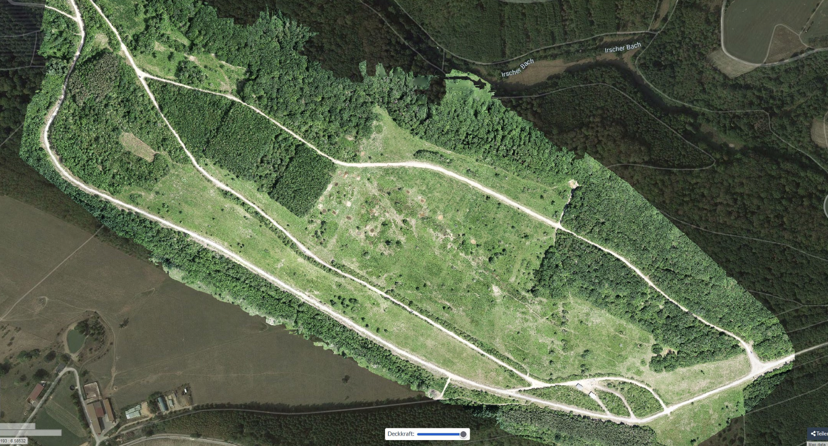
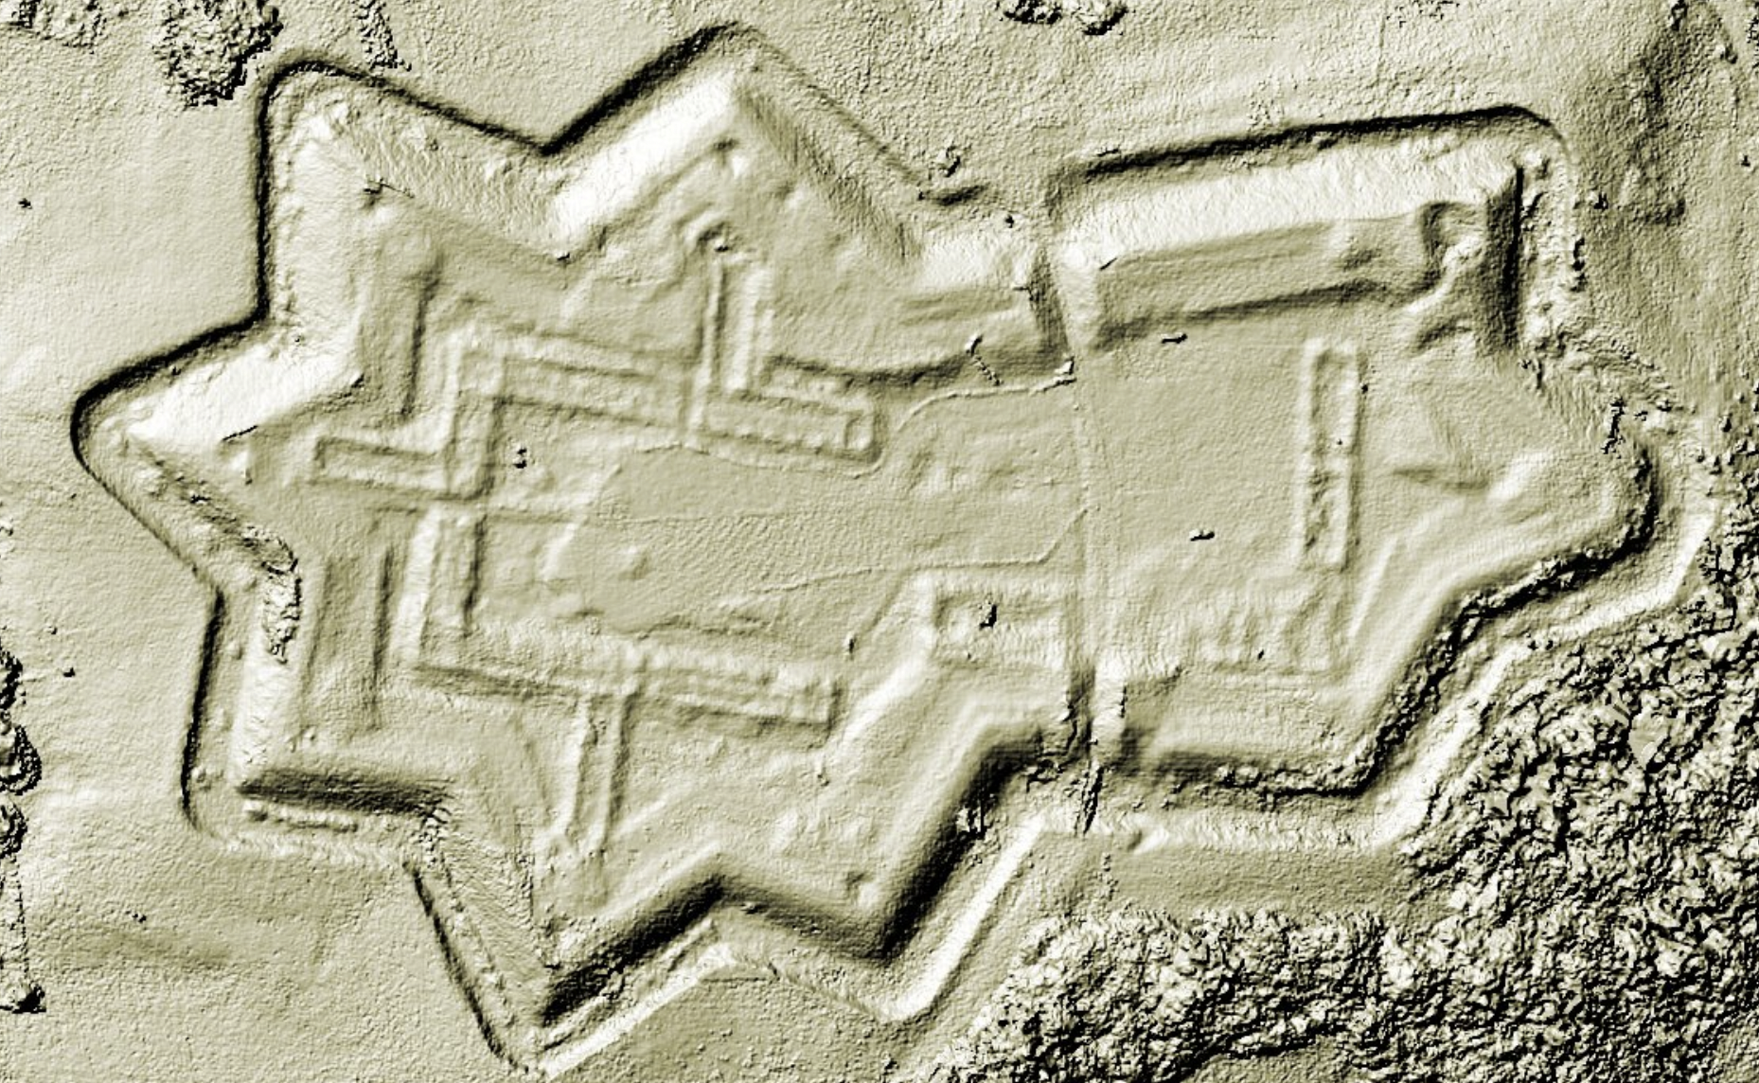
What is OpenDroneMap?
70 hectares grazing project with Longhorn cattle and Konik horses for nature conservation | credits: @sven_s8
Digital Surface Model | credits: @TomaszNycz

Slide 7
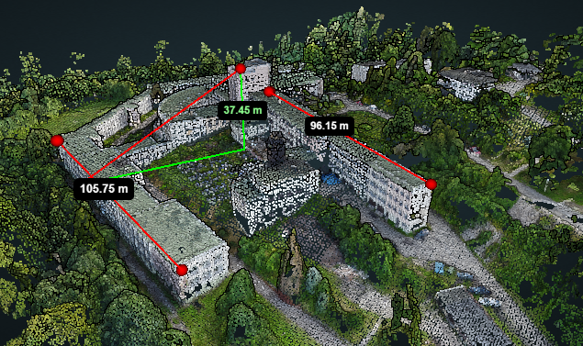
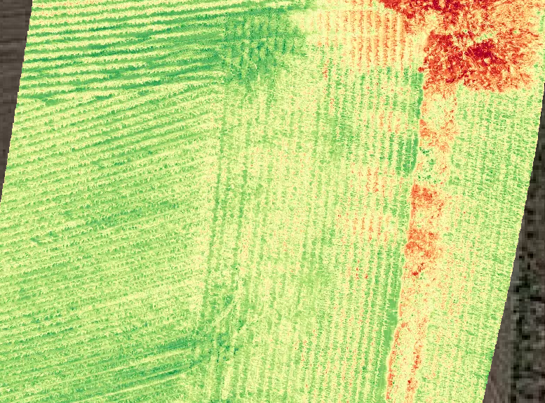
What is OpenDroneMap?
Structural measurements | credits: @TomaszNycz
Normalized difference vegetation index | credits: @aeret

Slide 8
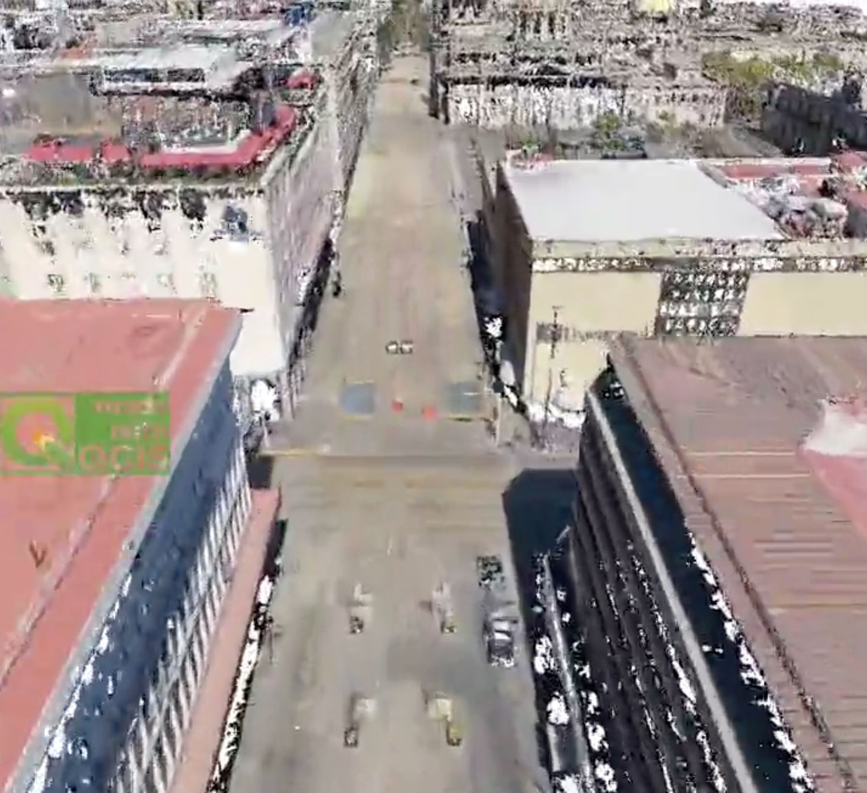
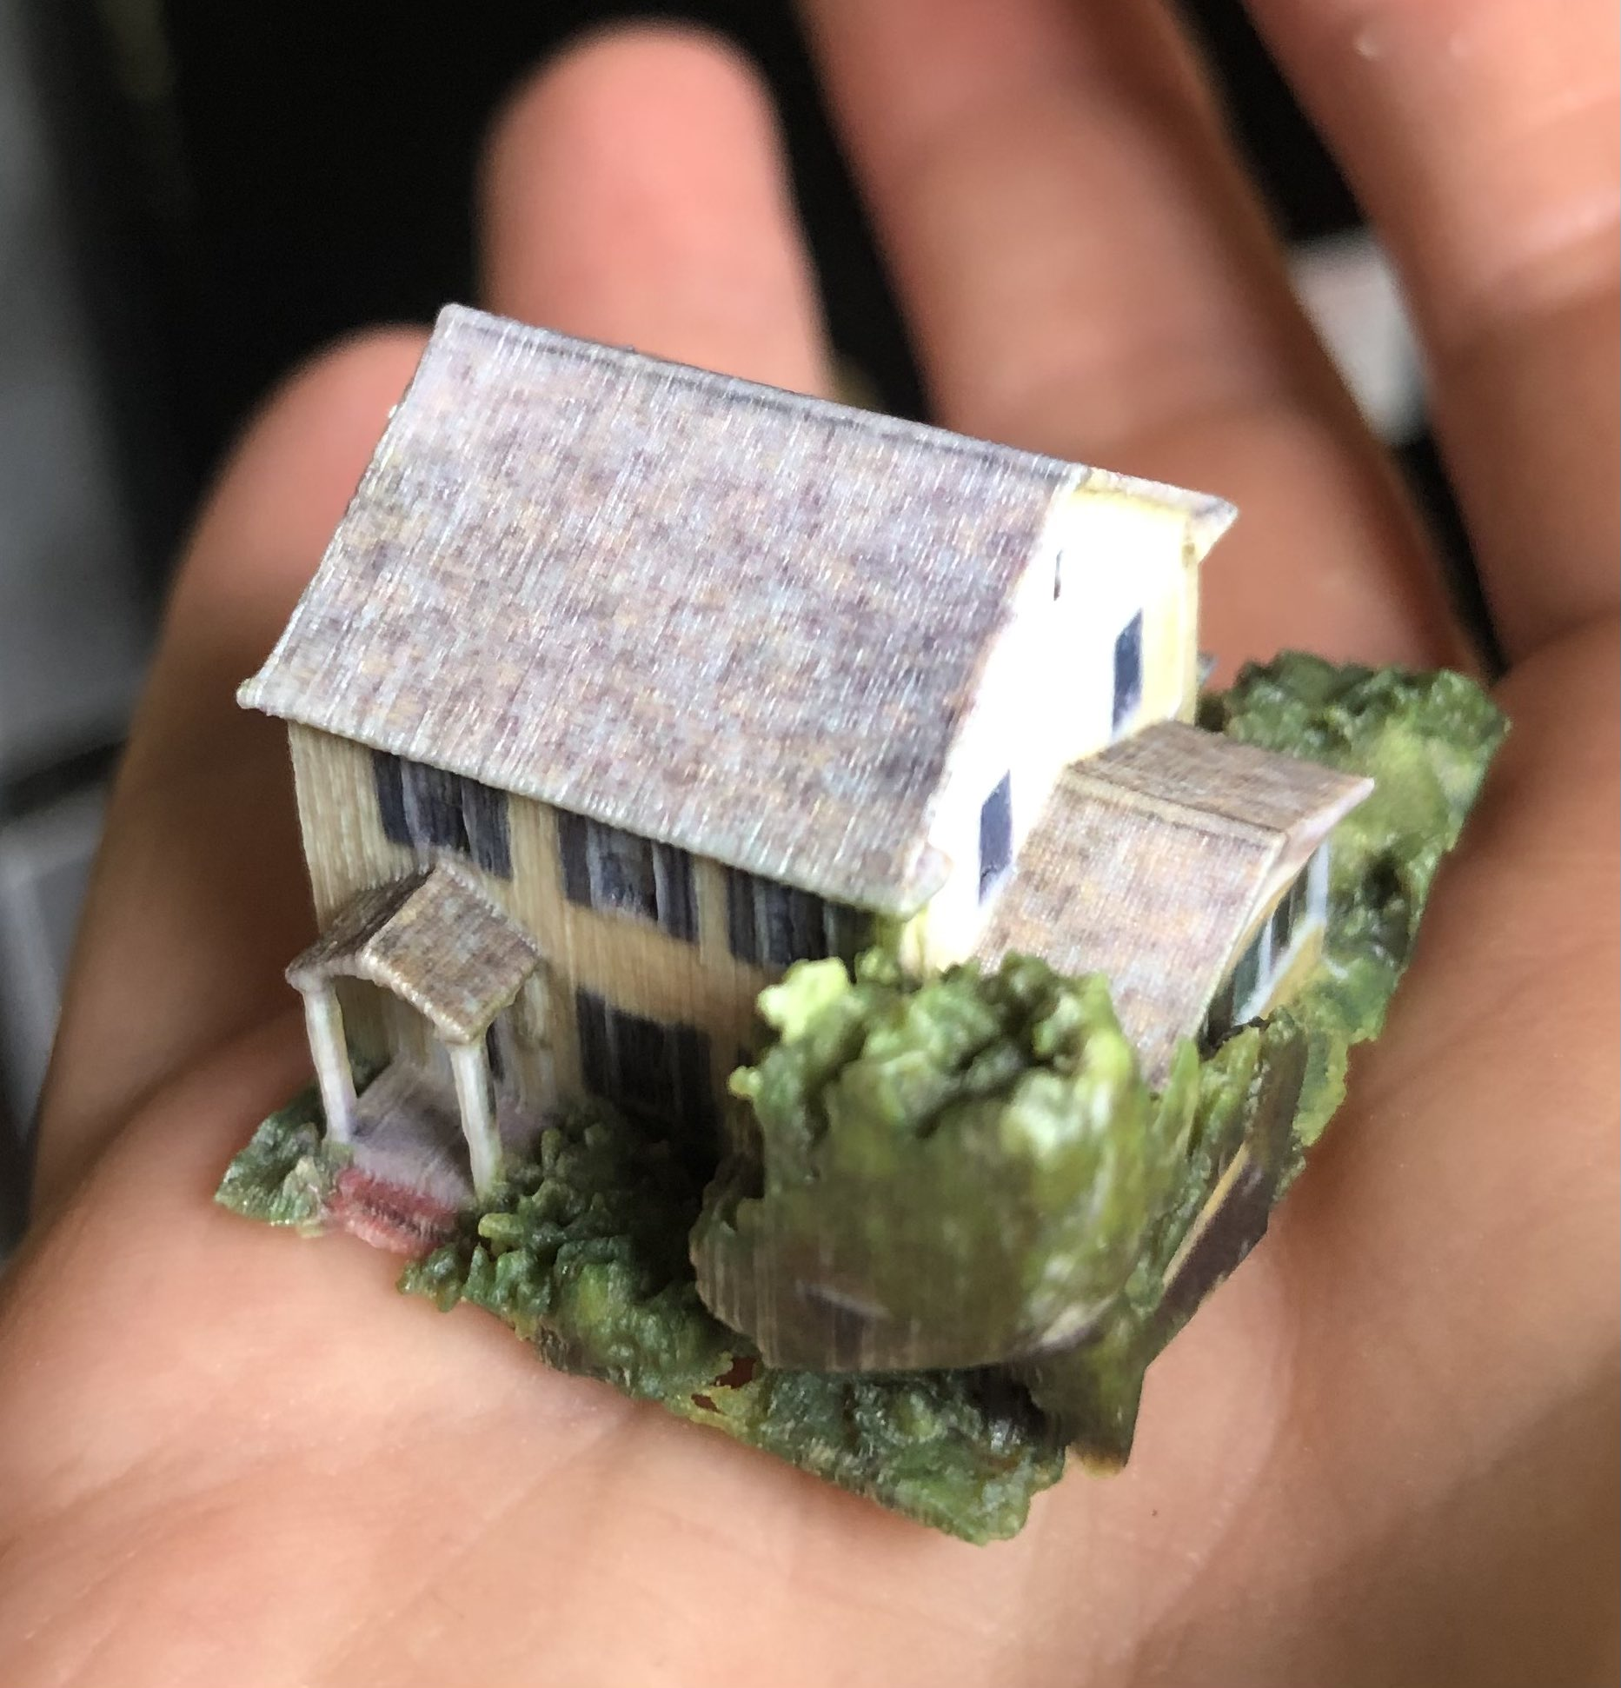
What is OpenDroneMap?
1,4 billion COPC opened in QGIS | credits: @hbecerra
3D printed house | credits: @smathermather

Slide 9
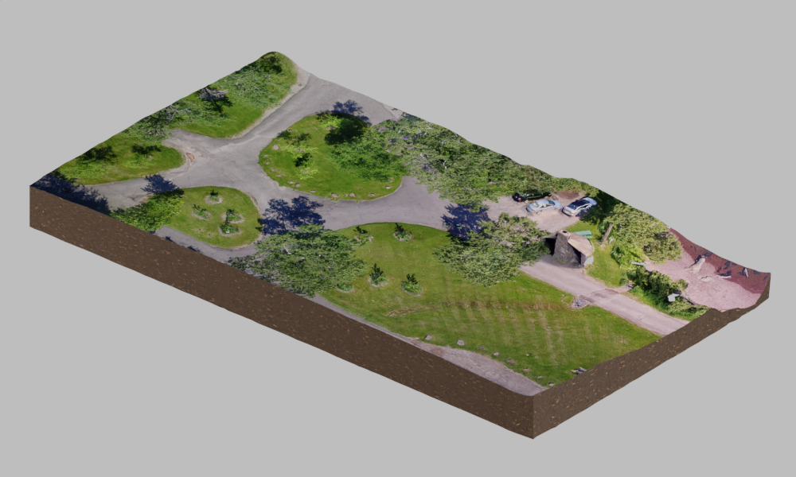
What is OpenDroneMap?
Brighton Beach 3D model + some Blender cleanup

Slide 10
How Get Started
Get a drone (any drone), capture some images
  Or use some test data: opendronemap.org/datasets
Download the software
  Follow the instructions on docs.opendronemap.org
  Or help fund the development by purchasing an installer (49€, one time) from opendronemap.org
Select the images, go get an espresso (we're in Italy after all...)

Slide 11
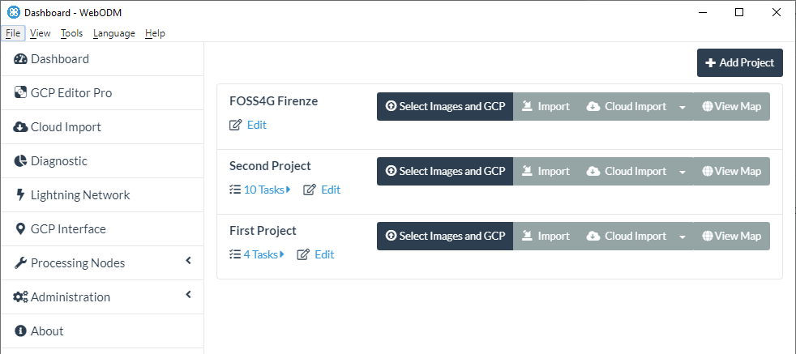
How To Get Started

Slide 12
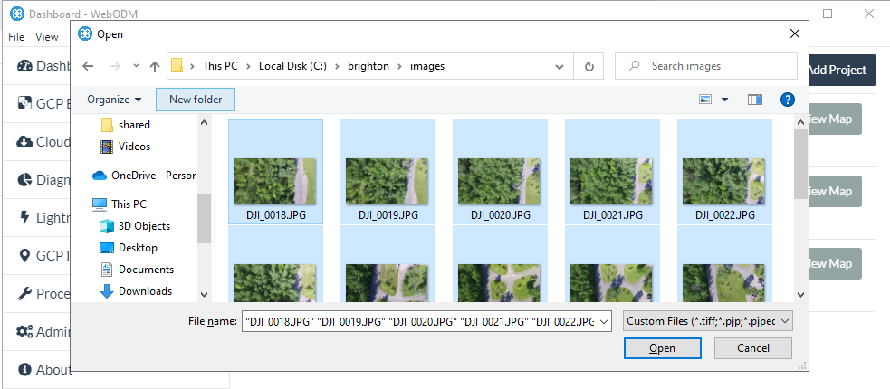
How To Get Started

Slide 13
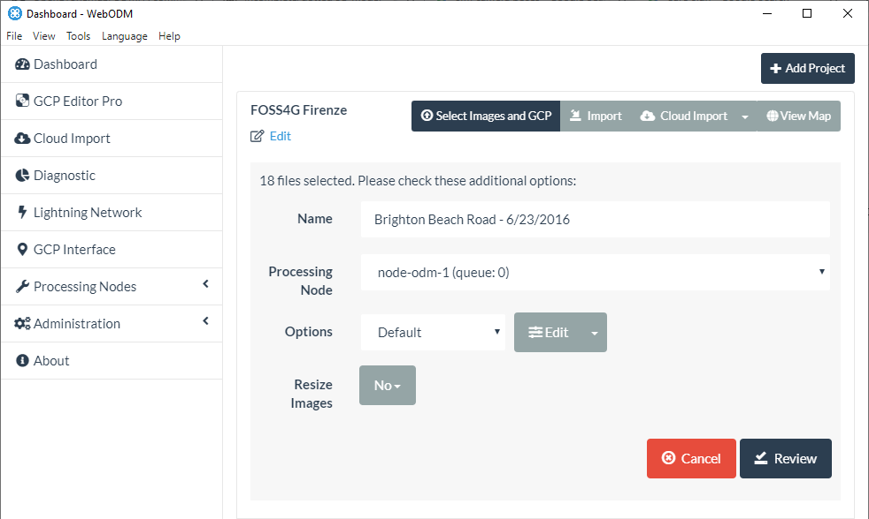
How To Get Started

Slide 14
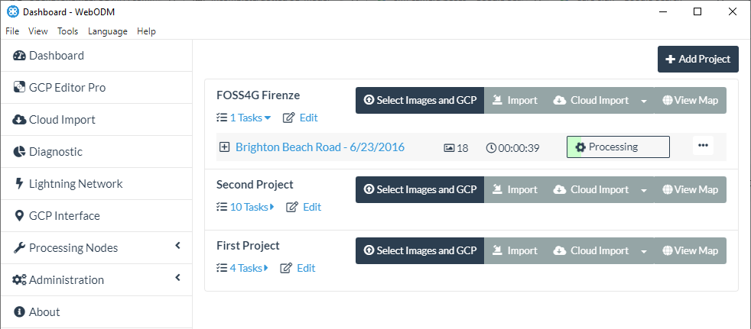
How To Get Started

Slide 15
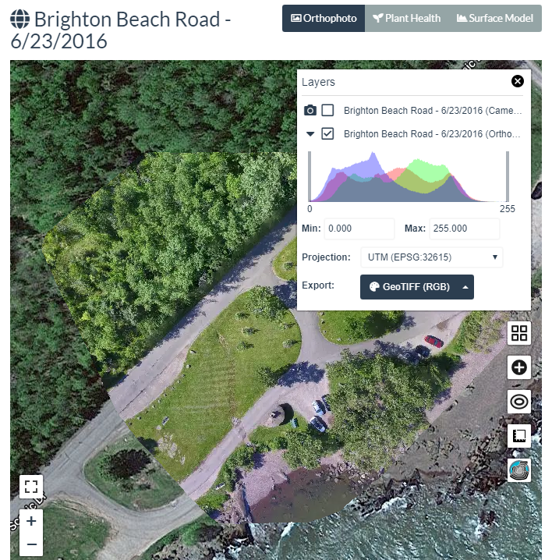
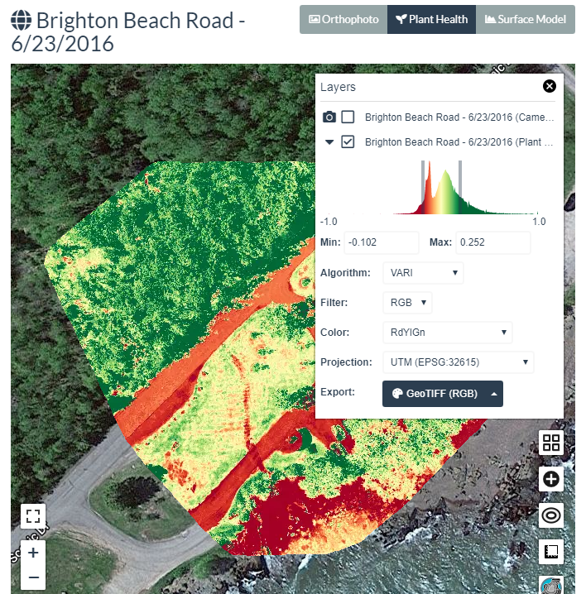
How To Get Started

Slide 16
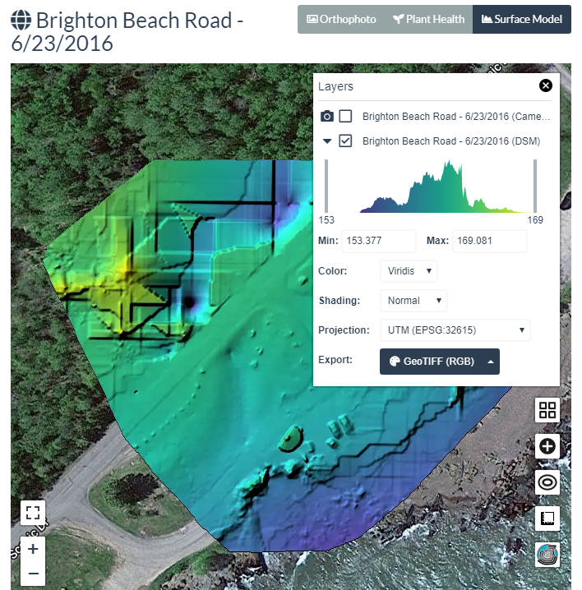
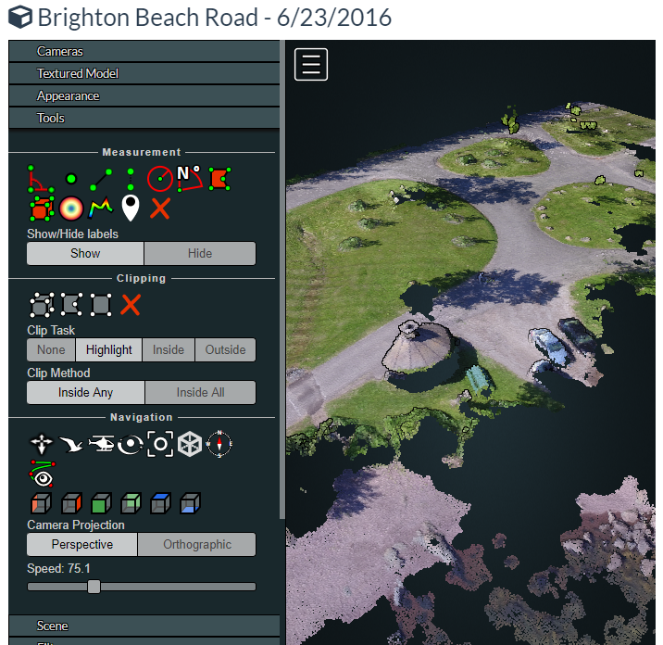
How To Get Started

Slide 17
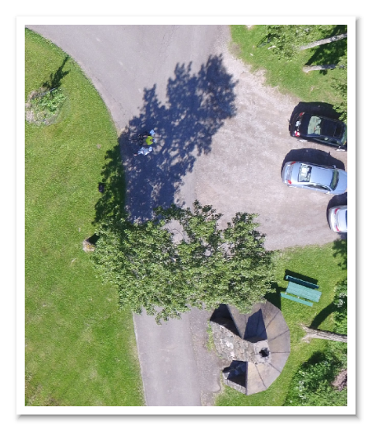
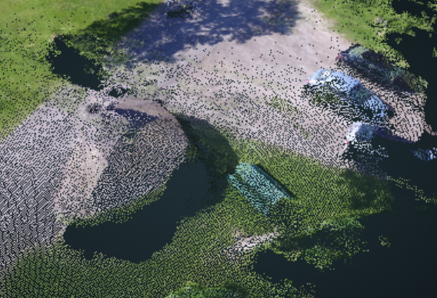
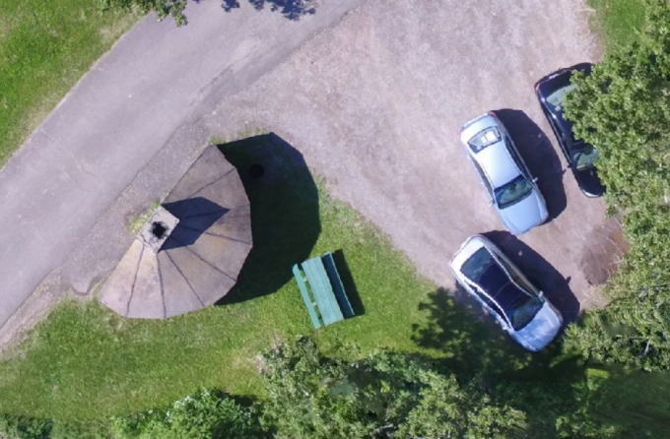
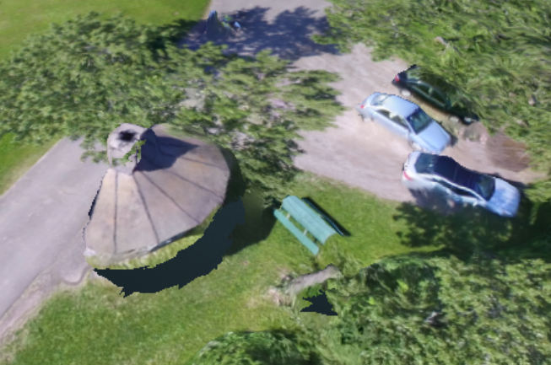
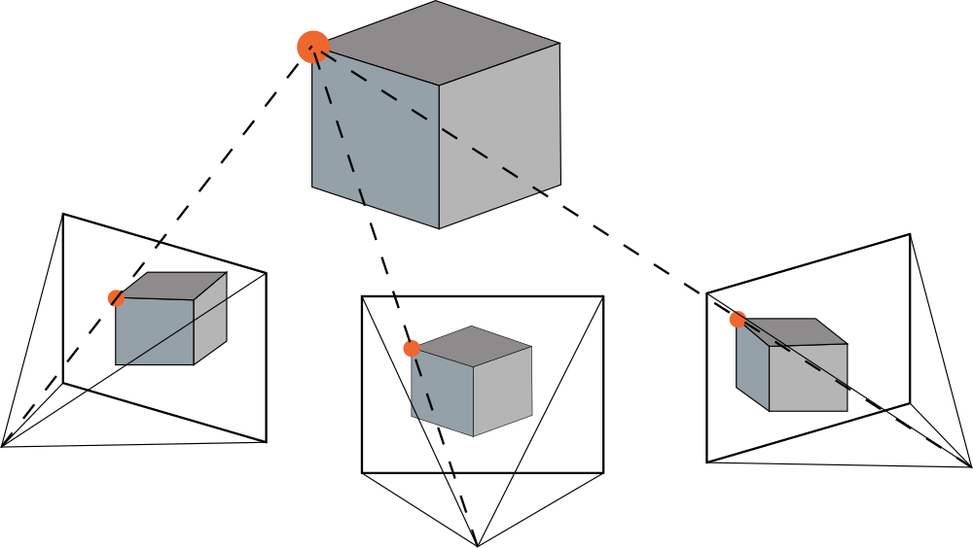
How it works (in a nutshell)
Images
SFM
Camera Poses
MVS
Point Cloud
Mesh + Texturing
Map

Slide 18
What's New

Slide 19
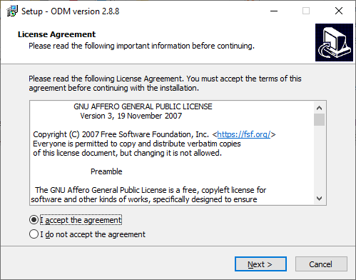
What's New
ODM Windows Native Support
  Binary releases from github.com/OpenDroneMap/ODM/releases
  No longer requires docker

Slide 20
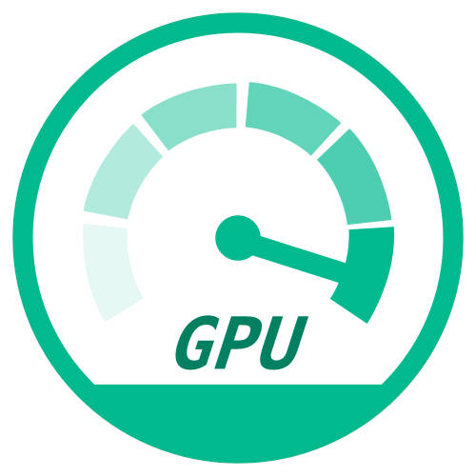
What's New
GPU Acceleration
  Massive speed up in point cloud generation (10x)
  NVIDIA only (for now..)
  Enabled by default on Windows
  Use opendronemap/odm:gpu docker image

Slide 21
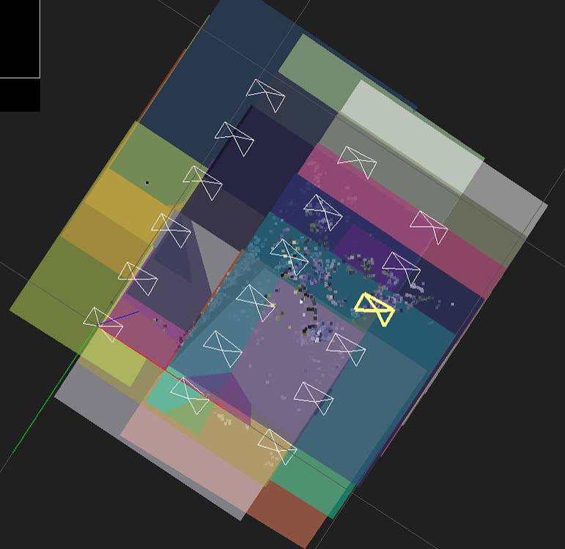
What's New
Planar Reconstructions (AG fields)
  Requirements: flat terrain, fixed altitude, nadir camera shots
  Massive speed-ups (~7x)
  Enable via --sfm-algorithm planar

Slide 22
What's New
Denser, More Accurate Point Clouds (credit to OpenMVS)
  Best verifiable benchmark score on tanksandtemples.org
  Geometric refinement (enable via --pc-geometric)

Slide 23
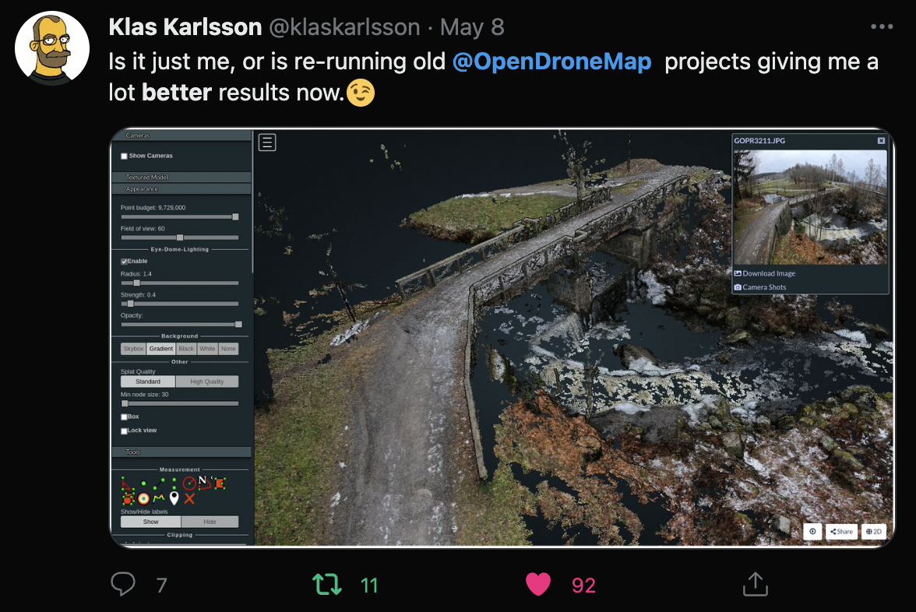

Slide 24
What's New
Multispectral Support
  State-of-the-art automatic band alignment
  Camera support
    Sentera
    MicaSense
    DJI
  Mixed 8bit RGB + 16bit TIFFs
  Automatic radiometric calibration
  Enable via --radiometric-calibration

Slide 25
What's New
Thermal Support
  Working in ODM
  Experimental WebODM support via "Plant Health"

Slide 26
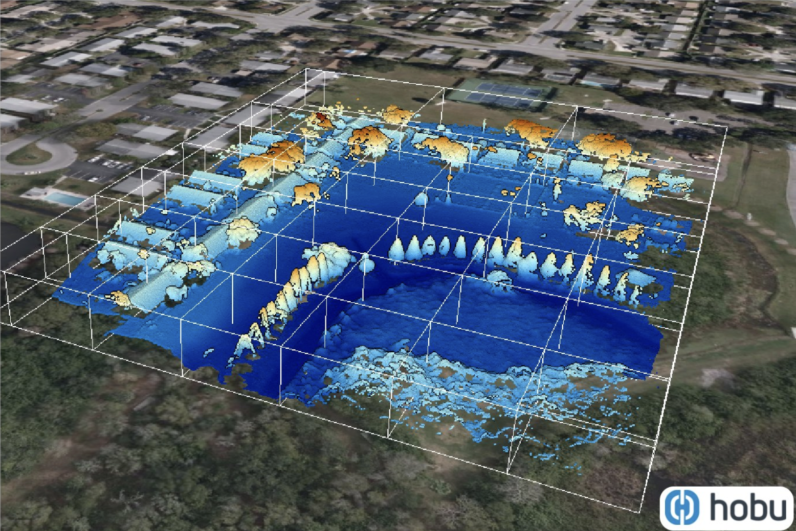
What's New
Cloud-Optimized Point Clouds
  copc.io
  Enable via --pc-copc

Slide 27
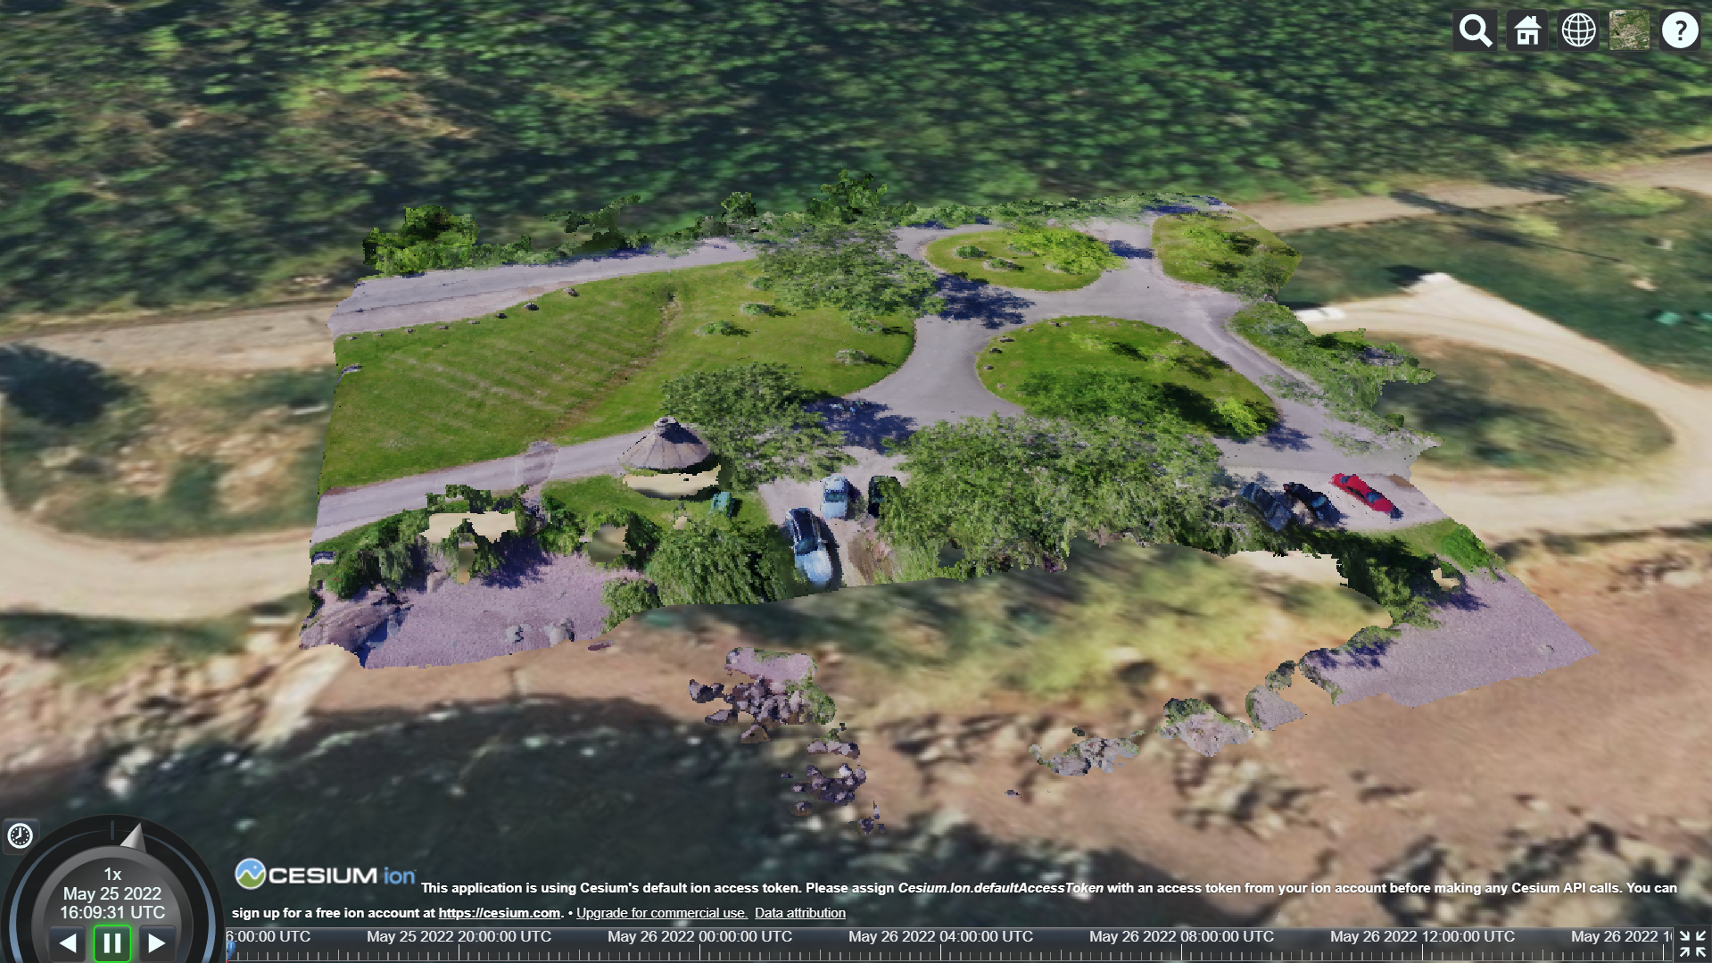
What's New
OGC 3D Tiles Generation (Cesium)
  Hierarchical Level of Detail (HLOD) 3D Meshes
    github.com/OpenDroneMap/Obj2Tiles
  Point Clouds
  Enable via --3d-tiles

Slide 28
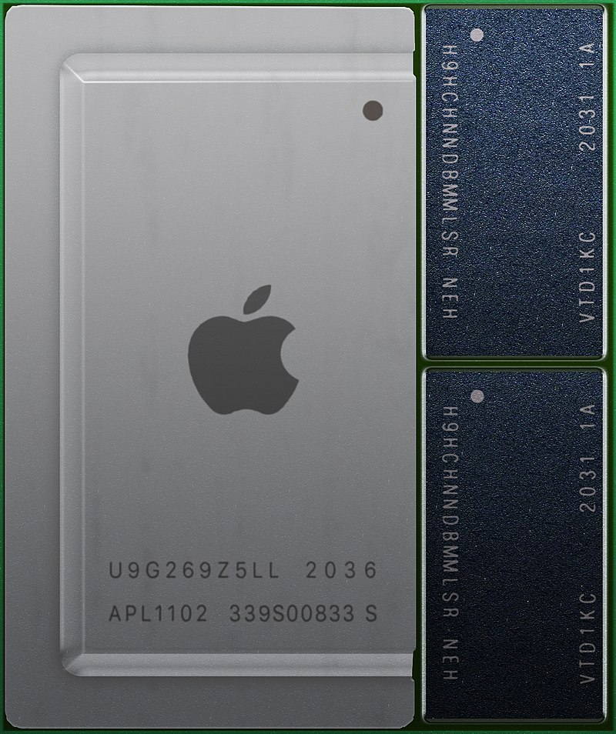
What's New
ARM64 Support
  Apple M1/M2 (via docker)
  ARM servers
Credit: Wikipedia @Henriok

Slide 29
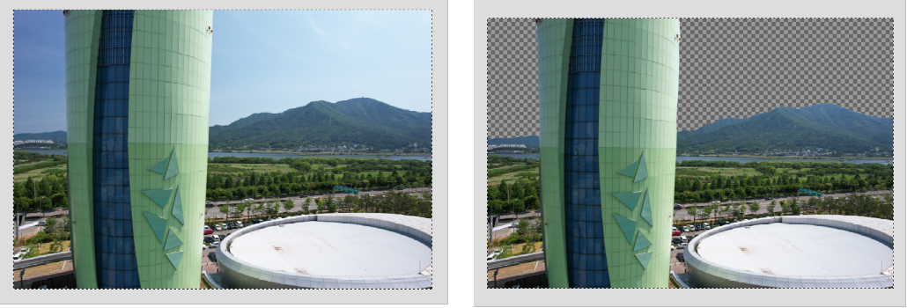
What's New
Smart Filtering Techniques
  AI-based Automated Sky Removal
    Enable via --sky-removal
  Automated cropping based on shots boundaries
    Enable via --auto-boundary

Slide 30
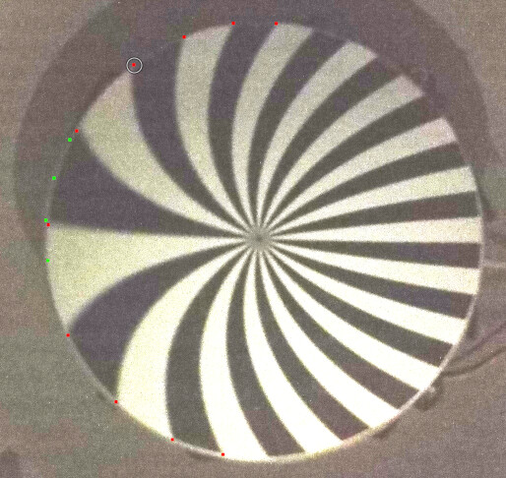
What's New
Rolling Shutter Correction
  Implementation of "A two-step approach for the correction of rolling shutter distortion in UAV photogrammetry" by Y. Zhou et al
  Rolling shutter readout database
  Enable via --rolling-shutter
  Readout time not in database? github.com/OpenDroneMap/RSCalibration

Slide 31
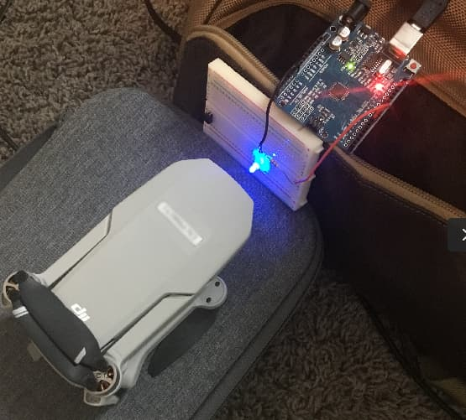
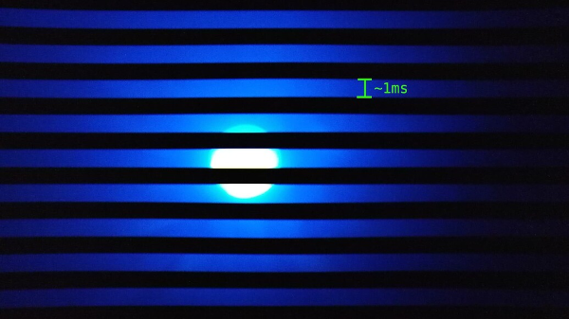
What's New

Slide 32
A Global Effort
Not a complete list
OpenSfM (Mapillary): Pau Gargallo, Yann Noutary
OpenMVS (3DNovator): Dan Cernea
PDAL (Hobu): Howard Butler, Andrew Bell, Connor Manning
Potree: Markus Schütz
Leaflet: Volodymyr Agafonkin
rio-tiler (Development Seed): Vincent Sarago
PoissonRecon (Johns Hopkins University): Michael Kazhdan
GDAL (OSGEO): Even Rouault
MVS Texturing (nFrames GmbH): Nils Moehrle
Countless others
You! opendronemap.org/get-involved

Slide 33
Our Approach
People before code
To accept a code contribution
Does it break?
Yes
Provide friendly help
No
Accept it
No but! Accept it
(You can always make changes later)
But... !

Slide 34
Our Approach
Do
  Merge pull requests quickly
  Encourage people to open pull requests
Don't:
  Ask for changes (unless broken or out of scope)
Takes effort, but worth it.

Slide 35
One Final Surprise...

Slide 36
Years in the making...

Slide 37
Announcing...

Slide 38
OpenDroneMap
(the org)
*Not an official/final logo
Incorporated in Ohio, United States
August 11th 2022
Stay tuned...

Slide 39
Questions

